Slide 1
TREE MAPS

Slide 2
What is a Tree Map?
Treemapping is a method for displaying hierarchical data using nested figures, usually rectangles.
Each branch of the tree is given a rectangle, which is then tiled with smaller rectangles representing sub-branches.
They make efficient use of space which can display thousands of items on the screen simultaneously.
The main distinguishing feature of a treemap, however, is the recursive construction that allows it to be extended to hierarchical data with any number of levels.

Slide 3
Properties:
It is stable
Preserves ordering
It is easy to implement

Slide 4
History
This idea was invented by professor Ben Shneiderman at the University of Maryland Human – Computer Interaction Lab in the early 1990s.

Slide 5
Example
The folder "My Documents" might contain "Pictures", "Videos", and "Documents". Those folders might also contain sub-folders and so on. The treemap was a way to visualize this large amount of data, many folders and subfolders, in an efficient way.

Slide 6
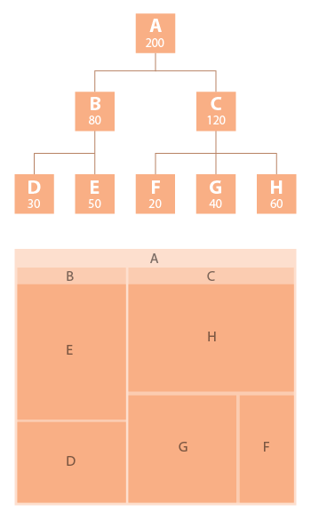
Example:

Slide 7
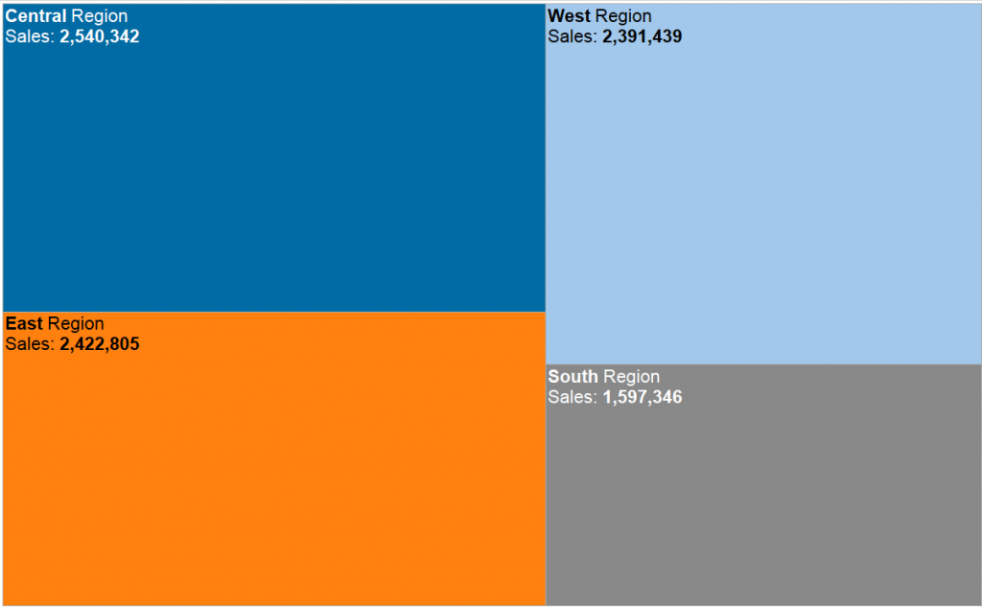
Simple Treemap(1 dimension only, now Region)

Slide 8
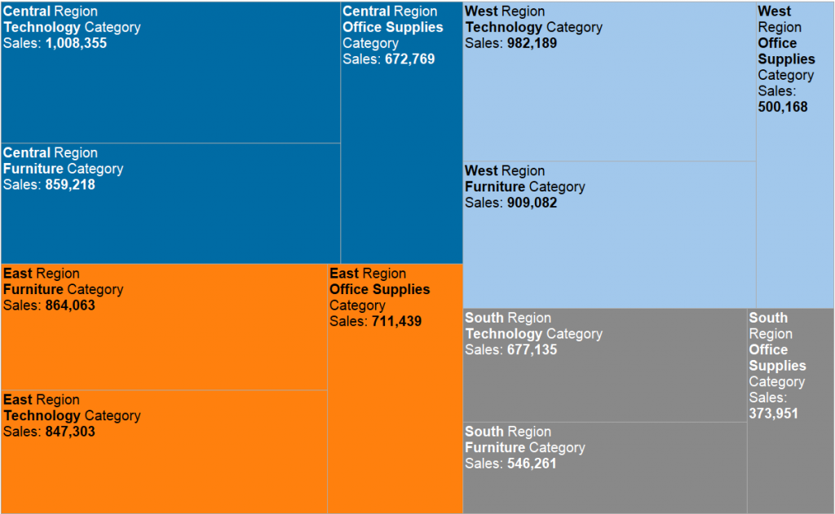
Nested Treemap(more dimensions, now Region & Product Category)

Slide 9
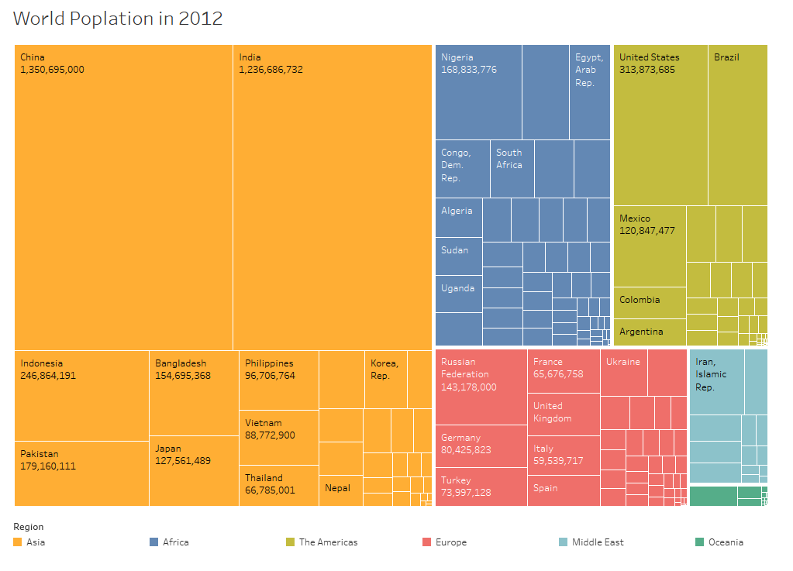

Slide 10
Advantages and Disadvantages:
Advantages:
Scalability
Node visibility
No overlapping marks
Disadvantages:
It impossible to make precise quantitative comparisons
Hard to identify the structure

Slide 11
Tools:
D3
Datamatic
Infogram
Tableau

Slide 12
THANK YOU

